Slide 1
Take the Wheel, Don’t Reinvent It! - Deploying Apps With Helm in 5 Minutes Christopher Hanson, Senior Associate Consultant RX-M Enterprises LLC

Slide 2
In 5 Minutes !!!
Why do I need Helm?
What is Helm?
How do I use Helm?

Slide 3

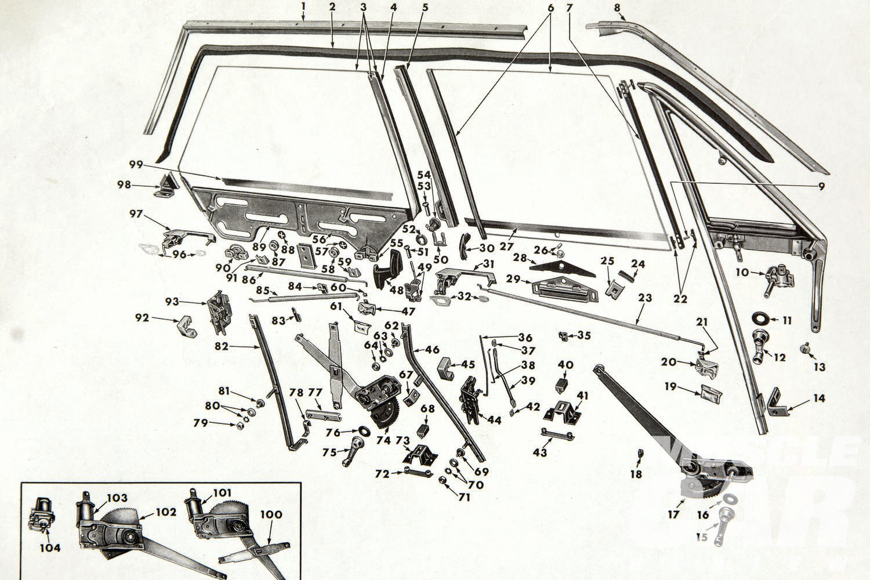
Fine grained parts
Kubernetes allows users to describe any application configuration they require
This flexibility requires Kubernetes application building blocks to be fine grained
Combined with the fact that cloud native applications are typically decomposed into small services, even simple applications can require many Kubernetes resources

Slide 4
A simple application
Container

Slide 5
A simple application
Pod
Container

Slide 6
A simple application
ReplicaSet
Pod
Container

Slide 7
A simple application
Deployment
ReplicaSet
Pod
Container

Slide 8
A simple application
Service
Deployment
ReplicaSet
Pod
Container

Slide 9
A simple application
Service
Deployment
Service Account
ReplicaSet
Pod
Container

Slide 10
A simple application
Service
Deployment
Service Account
ReplicaSet
Pod
Container
Roll

Slide 11
A simple application
Service
Deployment
Service Account
ReplicaSet
Pod
Roll Binding
Container
Roll

Slide 12
A simple application
Service
Deployment
Service Account
ReplicaSet
ConfigMap
Pod
Roll Binding
Container
Roll

Slide 13
A simple application
Service
secret
Deployment
Service Account
ReplicaSet
ConfigMap
Pod
Roll Binding
Container
Roll

Slide 14
A simple application
Service
secret
Deployment
Service Account
ReplicaSet
ConfigMap
Pod
Roll Binding
Container
Roll

Slide 15
A simple application
Service
secret
Deployment
Service Account
ReplicaSet
ConfigMap
Pod
Roll Binding
Container
Roll

Slide 16
A simple application
Service
secret
Deployment
Service Account
ReplicaSet
ConfigMap
Pod
Roll Binding
Container
Roll

Slide 17


can tame the madness

Slide 18
What is Helm?
The package manager for Kubernetes!
A great way to find, share, and use software built for Kubernetes
Helm collects all of the resources required to run an application into a single artifact: a Chart
Charts let you define, install, and upgrade complex Kubernetes applications as a single unit
Helm is a CNCF project with significant contributions from Microsoft, Google and Bitnami
https://helm.sh/

Slide 19
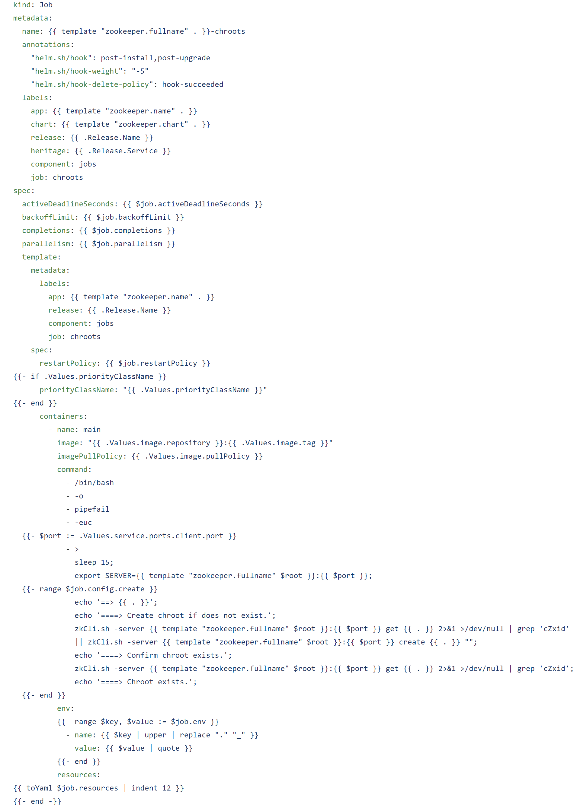
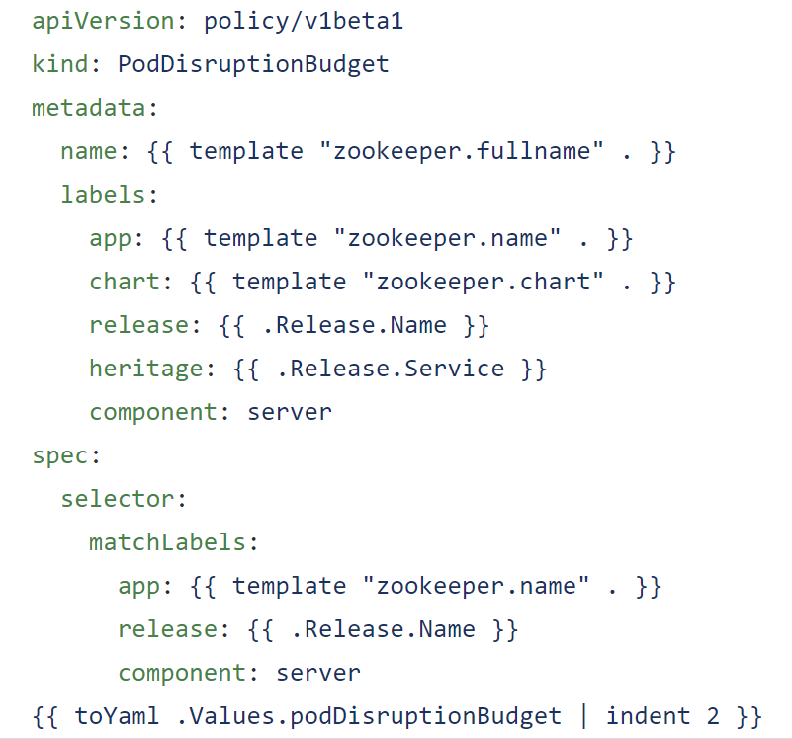
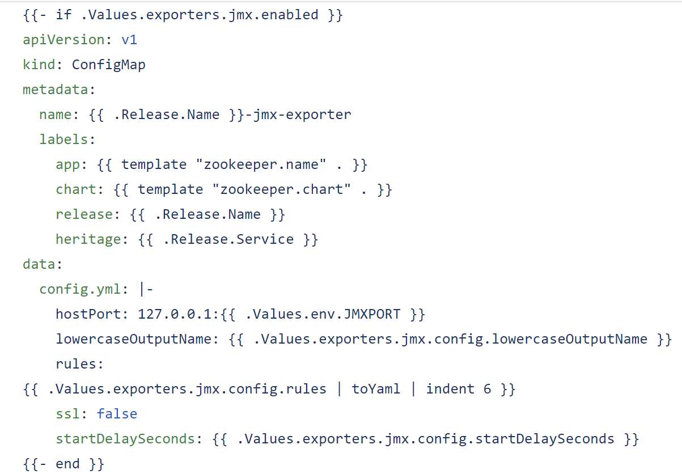
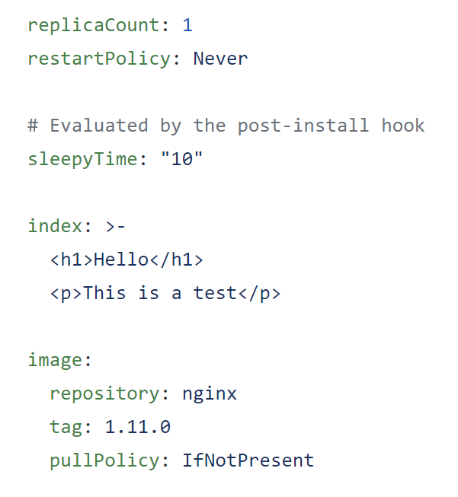
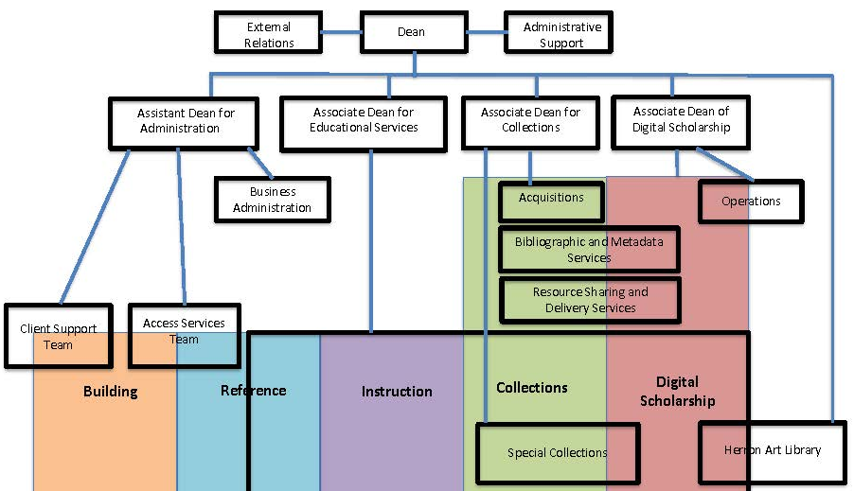
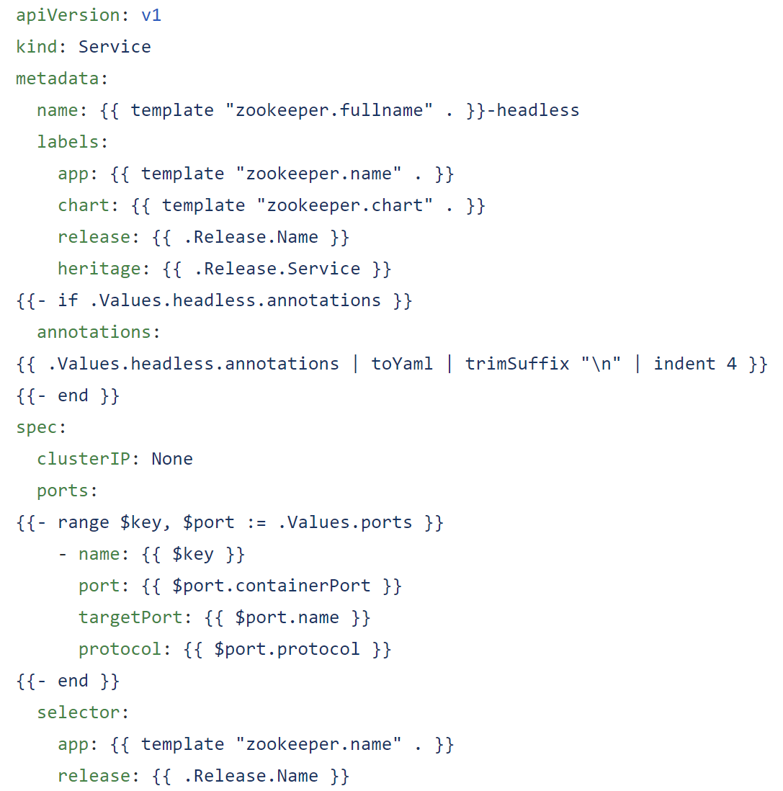
How Helm works
Simple Parameters Complex Charts Powerful Applications

Slide 20
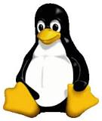
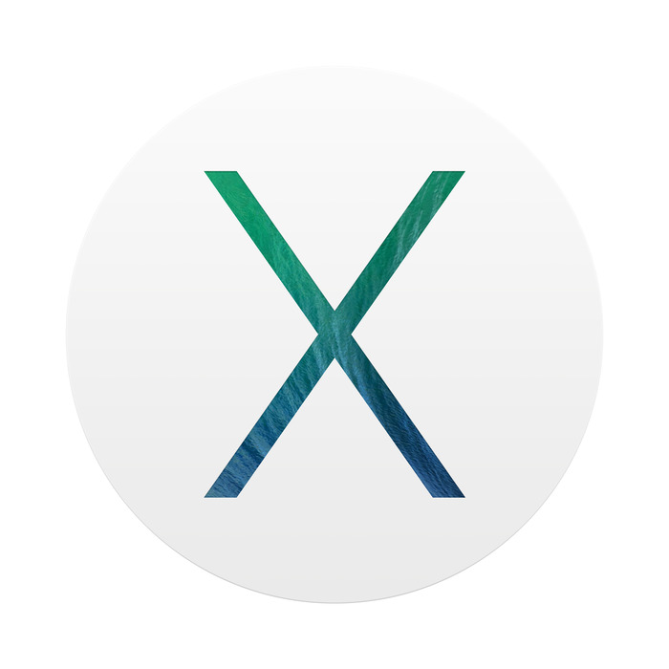
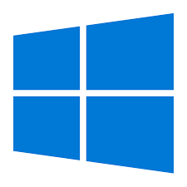
Installing Helm
From Snap (Linux)
$ sudo snap install helm
From Homebrew (macOS)
$ brew install kubernetes-helm
From Chocolatey (Windows)
C:\> choco install kubernetes-helm
From Script (GitHub)
https://raw.githubusercontent.com/helm/helm/master/scripts/get

Slide 21
Initializing Helm
$ helm init
Adding stable repo with URL: https://kubernetes-charts.storage.googleapis.com
Adding local repo with URL: http://127.0.0.1:8879/charts
$HELM_HOME has been configured at /home/user/.helm.
Tiller (the Helm server-side component) has been installed into your Kubernetes Cluster.
Please note: by default, Tiller is deployed with an insecure 'allow unauthenticated users' policy.
To prevent this, run `helm init` with the --tiller-tls-verify flag.
For more information on securing your installation see: https://docs.helm.sh/using_helm/#securing-your-helm-installation
Happy Helming!
$ kubectl create serviceaccount --namespace kube-system tiller
serviceaccount/tiller created
$ kubectl create clusterrolebinding tiller-cluster-rule \ --clusterrole=cluster-admin --serviceaccount=kube-system:tiller
clusterrolebinding.rbac.authorization.k8s.io/tiller-cluster-rule created
$ kubectl patch deploy --namespace kube-system tiller-deploy \ -p '{"spec":{"template":{"spec":{"serviceAccount":"tiller"}}}}'
deployment.extensions/tiller-deploy patched
helm init uses the current kubectl context from $HOME/<username>/.kube/config
to configure the target Kubernetes cluster for use with Helm
To enable Helm’s server to function in an RBAC system the Helm deployment (tiller-deploy) must be given a service account (typically named “tiller”) bound to the cluster admin role

Slide 22
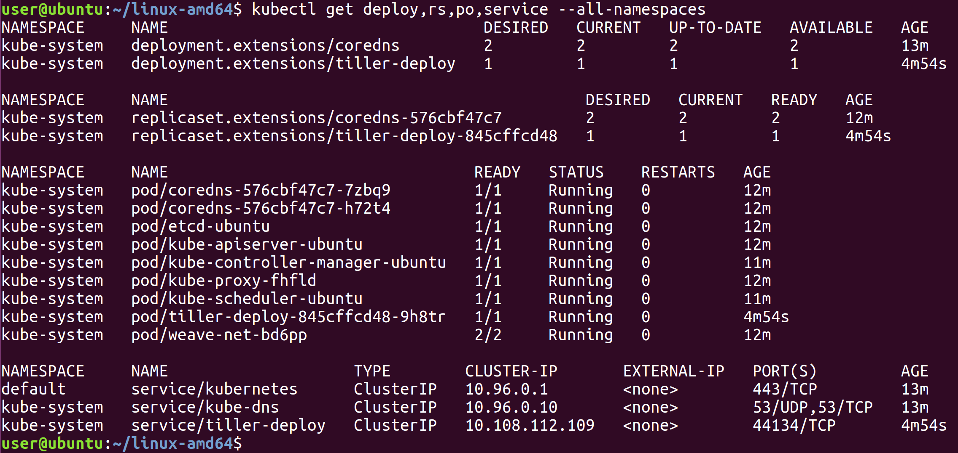
Tiller
The helm CLI init command launches Helm’s server, Tiller on the configured cluster
Tiller runs as a single pod deployment with the “tiller-deploy” service in the kube-system namespace

Slide 23
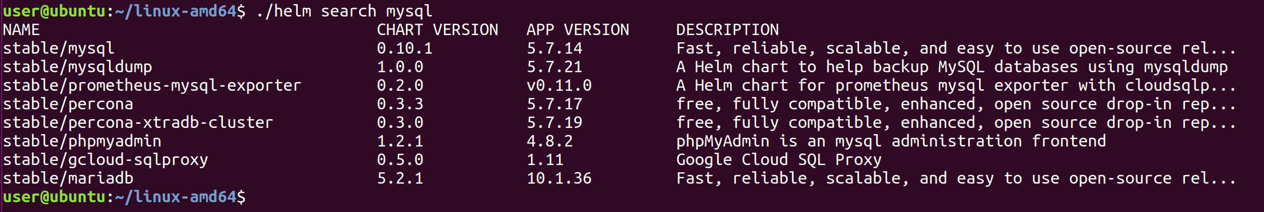
Concepts
A Chart is a Helm package
Charts contain all of the resource definitions necessary to run an application
A Repository is the place where charts can be collected and shared
A Release is an instance of a chart running in a Kubernetes cluster

Slide 24
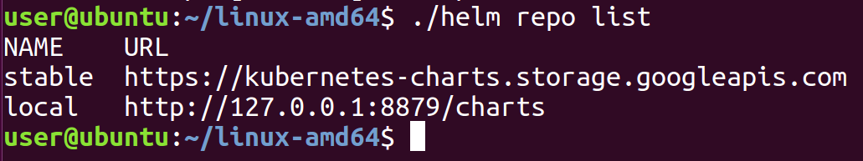
Running applications
user@ubuntu:~/linux-amd64$ ./helm install stable/mysql
NAME: full-joey
LAST DEPLOYED: Fri Oct 19 00:45:55 2018
NAMESPACE: default
STATUS: DEPLOYED
RESOURCES:
==> v1/Pod(related)
NAME READY STATUS RESTARTS AGE
full-joey-mysql-c566bbf7-78vvm 0/1 Pending 0 0s
==> v1/Secret
NAME AGE
full-joey-mysql 0s
==> v1/ConfigMap
full-joey-mysql-test 0s
==> v1/PersistentVolumeClaim
full-joey-mysql 0s
==> v1/Service
full-joey-mysql 0s
==> v1beta1/Deployment
full-joey-mysql 0s
NOTES:
MySQL can be accessed via port 3306 on the following DNS name from within your cluster:
full-joey-mysql.default.svc.cluster.local
To get your root password run:
MYSQL_ROOT_PASSWORD=$(kubectl get secret --namespace default full-joey-mysql -o jsonpath="{.data.mysql-root-password}" | base64 --decode; echo)
To connect to your database:
1. Run an Ubuntu pod that you can use as a client:
kubectl run -i --tty ubuntu --image=ubuntu:16.04 --restart=Never -- bash -il
2. Install the mysql client:
$ apt-get update && apt-get install mysql-client -y
3. Connect using the mysql cli, then provide your password:
$ mysql -h full-joey-mysql -p
To connect to your database directly from outside the K8s cluster:
MYSQL_HOST=127.0.0.1
MYSQL_PORT=3306
# Execute the following command to route the connection:
kubectl port-forward svc/full-joey-mysql 3306
mysql -h ${MYSQL_HOST} -P${MYSQL_PORT} -u root -p${MYSQL_ROOT_PASSWORD}
user@ubuntu:~/linux-amd64$
When you install a chart, a new release is created.
One chart can be installed many times in the same cluster.
Each release is given a name and can be independently parameterized, managed and upgraded
The helm install command is used to launch applications on the configured Kubernetes cluster
Charts can be installed from Repositories; curated charts for many common applications can be installed from the public repo: https://kubernetes-charts.storage.googleapis.com
helm install “releases” the chart, combining it with configuration parameters (from the source repo in this case)
The example release here is: full-joey

Slide 25
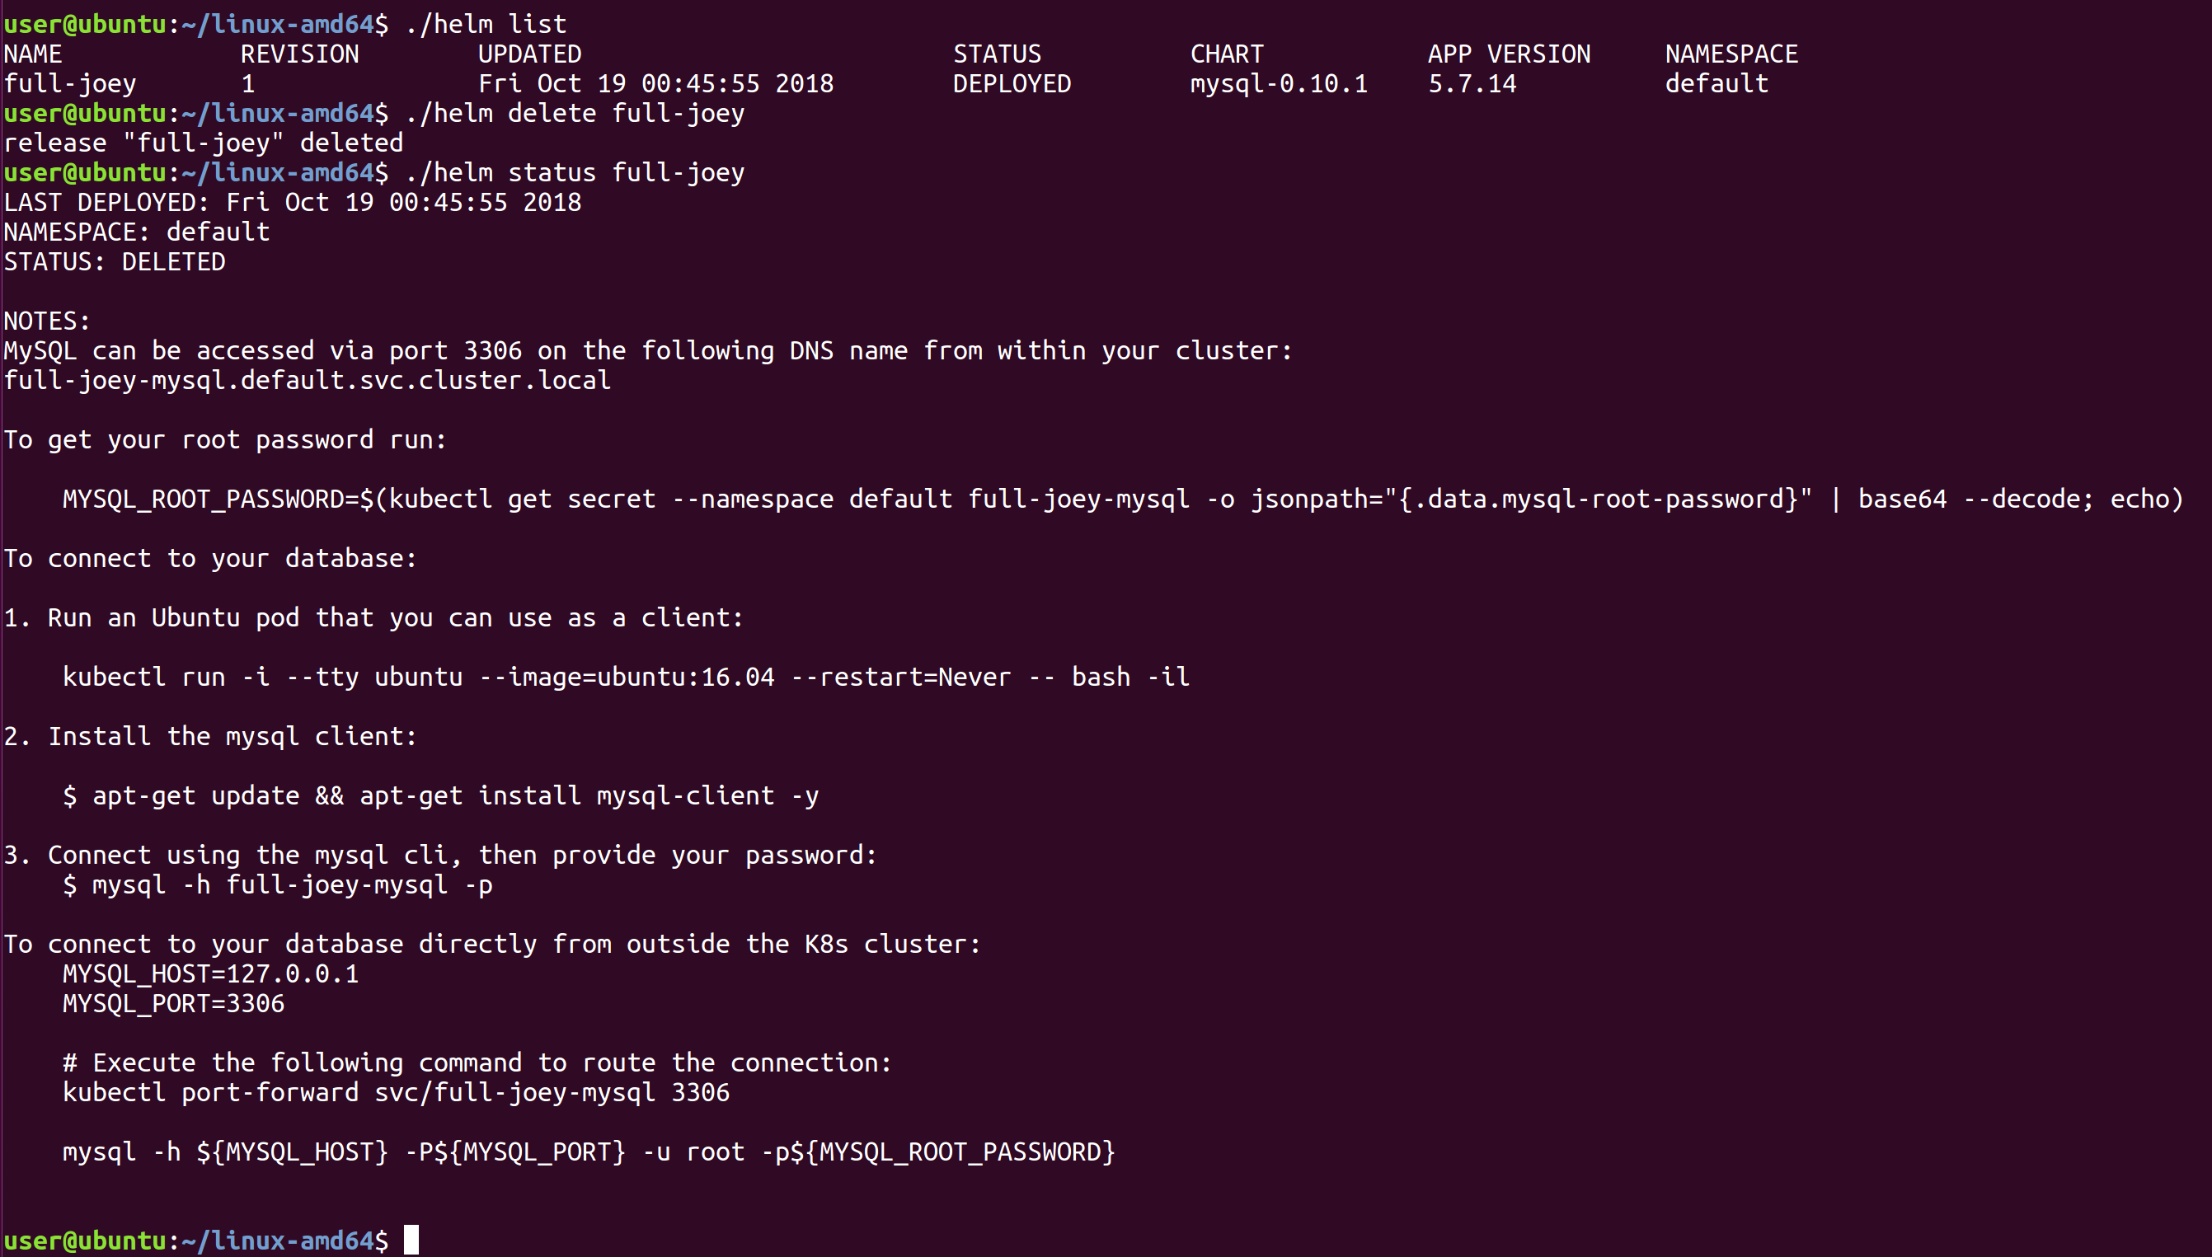
Controlling applications
Helm has many commands for working with applications
$ helm status
$ helm inspect
$ helm list
$ helm upgrade
$ helm rollback
$ helm delete

Slide 26
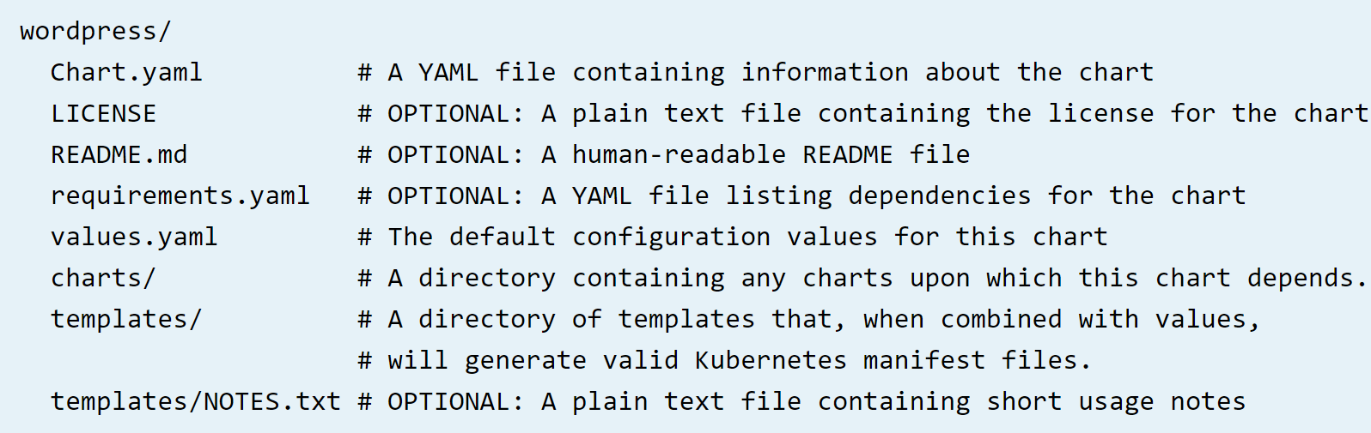
Chart Layout
A Chart is a collection of files defining the resources necessary to launch a Kubernetes application
Charts can be packaged into versioned archives to be deployed
Charts have a required set of files and directory structure

Slide 27
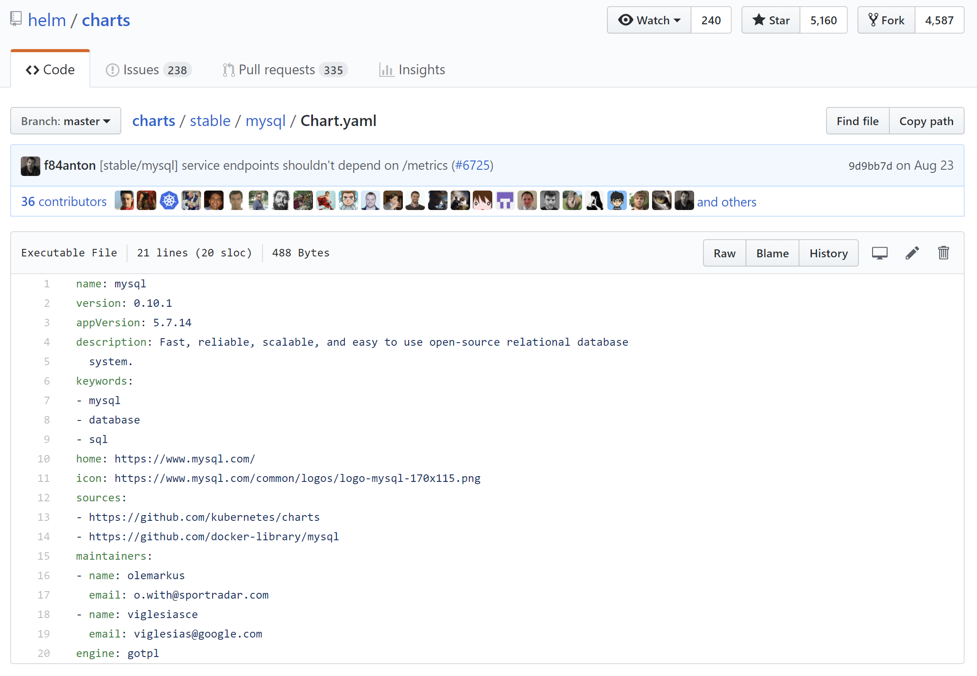
The Chart.yaml
The Chart.yaml file is required and provides high level information about the Chart application
Chart.yaml file fields:
apiVersion: The chart API version, always "v1"
name: The name of the chart (required)
version: A SemVer 2 version (required)
appVersion: The version of the app that this contains (optional). description: A single-sentence description of this project (optional)
keywords: A list of keywords about this project (optional)
home: The URL of this project's home page (optional)
icon: A URL to an SVG or PNG image (optional)
sources: A list of URLs to source code for this project (optional)
maintainers: # (optional)
name: The maintainer's name (required for each maintainer)
email: The maintainer's email (optional for each maintainer)
url: A URL for the maintainer (optional for each maintainer)
engine: Name of the template engine (optional, defaults to gotpl)
deprecated: Whether this chart is deprecated (optional, boolean)

Slide 28
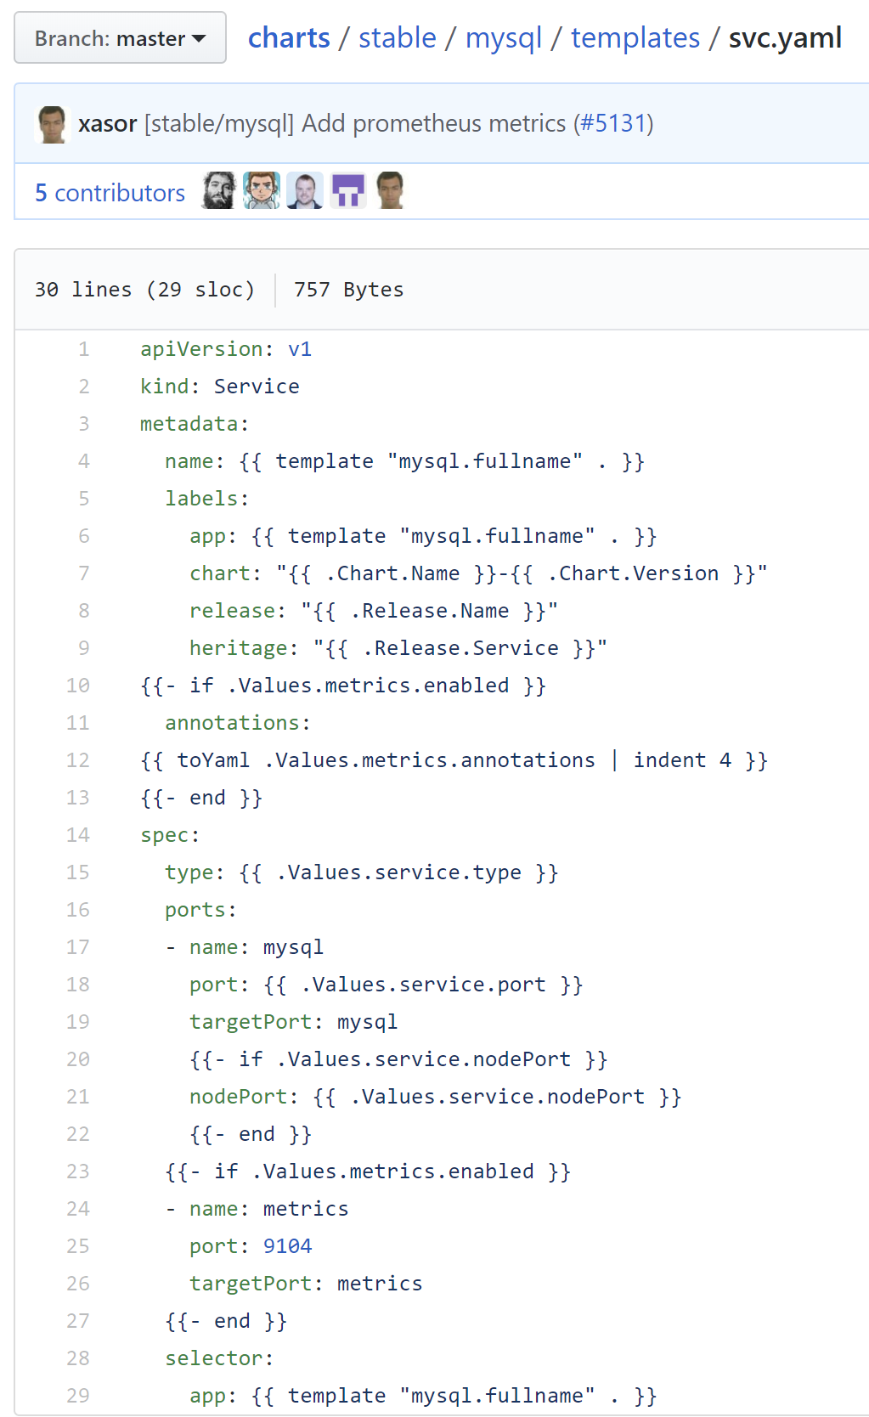
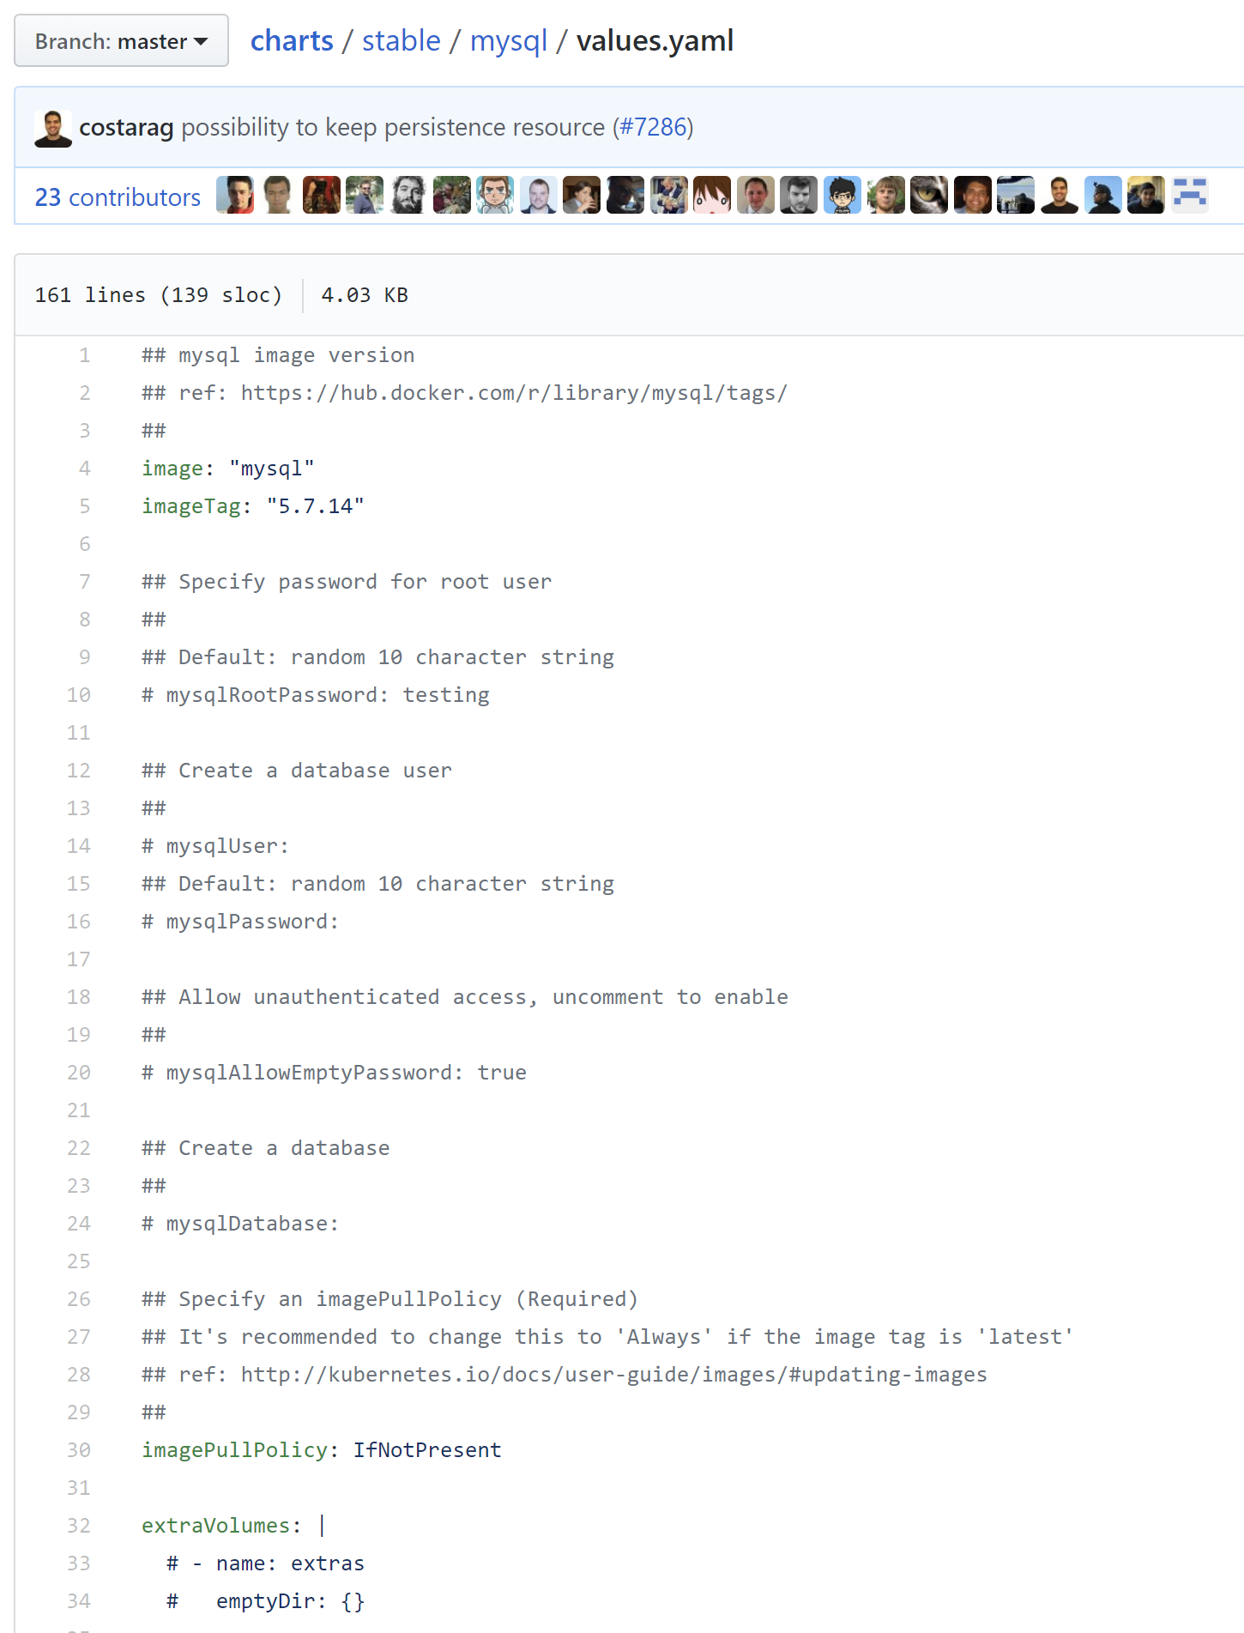
Templates
Based Go templates with a few add-ons
Stored in a chart’s templates/ folder
Contain place holders for values that can be supplied by users
When Helm installs a chart it passes every file in templates/ through the template engine resolving the template variables
Values for template variables can be supplied two ways:
Chart developers may supply a file called values.yaml in chart repo
Chart users may supply a YAML file that contains values on the command line or use the --set flag to pass a variable imperatively

Slide 29
In 5 Minutes !!!
Why do I need Helm?
Because K8s apps require coordinated deployment of large sets of complex resources
What is Helm?
A tool for coordinating deployment of large sets of complex resources!!!
How do I use Helm?
helm install pre-built charts from the public repo !!!

Slide 30
Beyond 5 Minutes…
What's Next?
Security – the default installation doesn't apply any security config
Multitenancy – Tiller has a one-to-many relationship with kubernetes namespaces (multi-Tiller? Tillerless Helm?)
Create your own charts – helm makes it easy to create new charts, find common problems in chart code, and package charts into tarballs for deployment and installation
Private Repository – HTTP server that houses an index.yaml file and packaged charts (ChartMuseum!)

Slide 31
Time to start helming!

